Slide 1
Learning Face Age Progression: A Pyramid Architecture of GANs

Slide 2
Group Details
Ali Khalid(MSDS21001)
Muhammad Maisam Abbas(MSDS21003)

Slide 3
Problem Statement
To develop a generative model that can introduce age-specific facial changes in the input image while retaining the subject-specific characteristic.

Slide 4
Related Work
Physical Models
using aging mechanisms of cranium and facial muscles. [1]
3-layered dynamic skin model to simulate wrinkles. [2]

Slide 5
Related Work
Data Driven Models
RNN model [3]
modeling the intermediate transition states in an RNN model
multiple face images of various ages of each subject were required at the training stage, and the exact age label of the probe face was needed during test, thus greatly limiting its flexibility
Temporal Non-Volume Preserving [4]
the short-term age progression was accomplished by mapping the data densities of two consecutive age groups with ResNet blocks, and the long-term aging synthesis was finally reached by a chaining of short-term stages.
Its major weakness, however, was that it merely considered the probability distribution of a set of faces without any individuality information. As a result, the synthesized faces in a complete aging sequence varied a lot in color, expression, and even identity

Slide 6
Selected Paper
Yang, Hongyu, et al. "Learning face age progression: A pyramid architecture of gans." Proceedings of the IEEE conference on computer vision and pattern recognition. 2018.

Slide 7
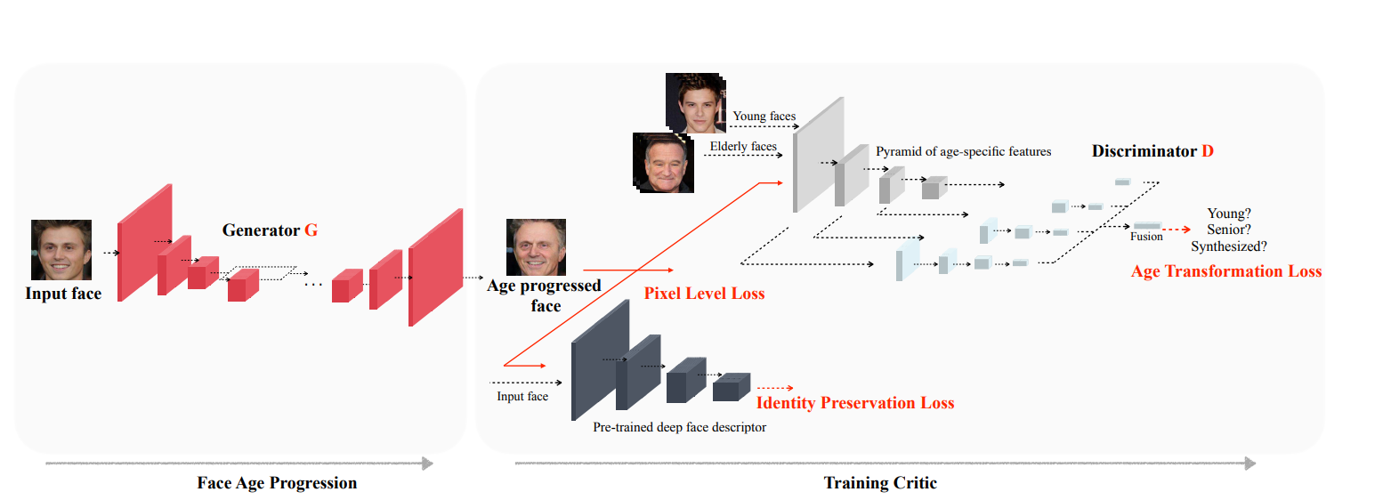
Methodology

Slide 8
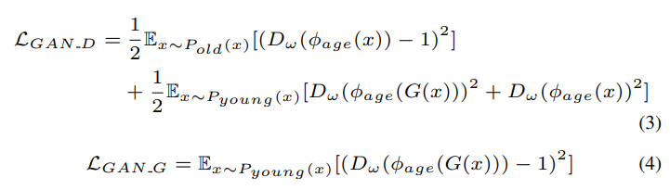


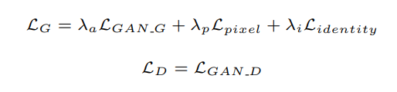
Methodology
least squares loss substituting for the negative log likelihood objective, which penalizes the samples depending on how close they are to the decision boundary

Slide 9
Dataset
MORPH mugshot dataset [5]
52,099 color images with near-frontal pose, neutral expression, and uniform illumination.
The subject age ranges from 16 to 77 years old, with the average age being approximately 33.
The longitudinal age span of a subject varies from 46 days to 33 years.
Cross-Age Celebrity Dataset (CACD) [6]
collected via the Google Image Search.
containing 163,446 face images of 2,000 celebrities across 10 years, with age ranging from 14 to 62.

Slide 10
Dataset
FG-NET
1,002 images from 82 individuals
Note:
MORPH and CACD for used for training and validation.
FG-NET was used for testing and comparison with prior work.

Slide 11
Evaluation Metrics
Visual Fidelity
Aging Accuracy
Identity Preservation

Slide 12
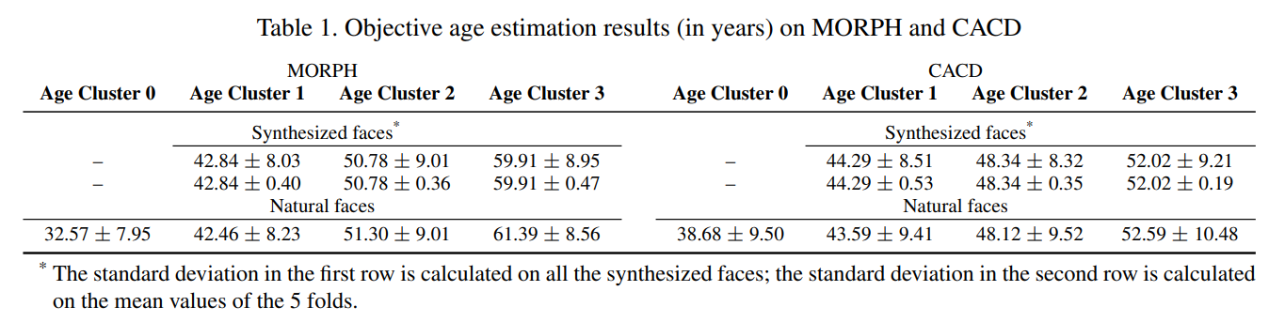
Results

Slide 13
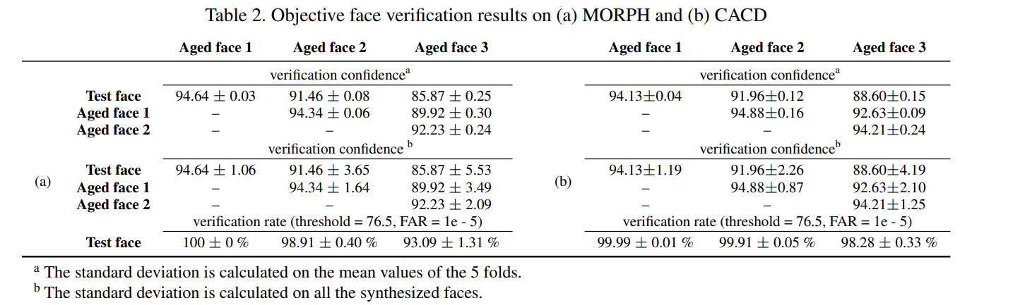
Results

Slide 14
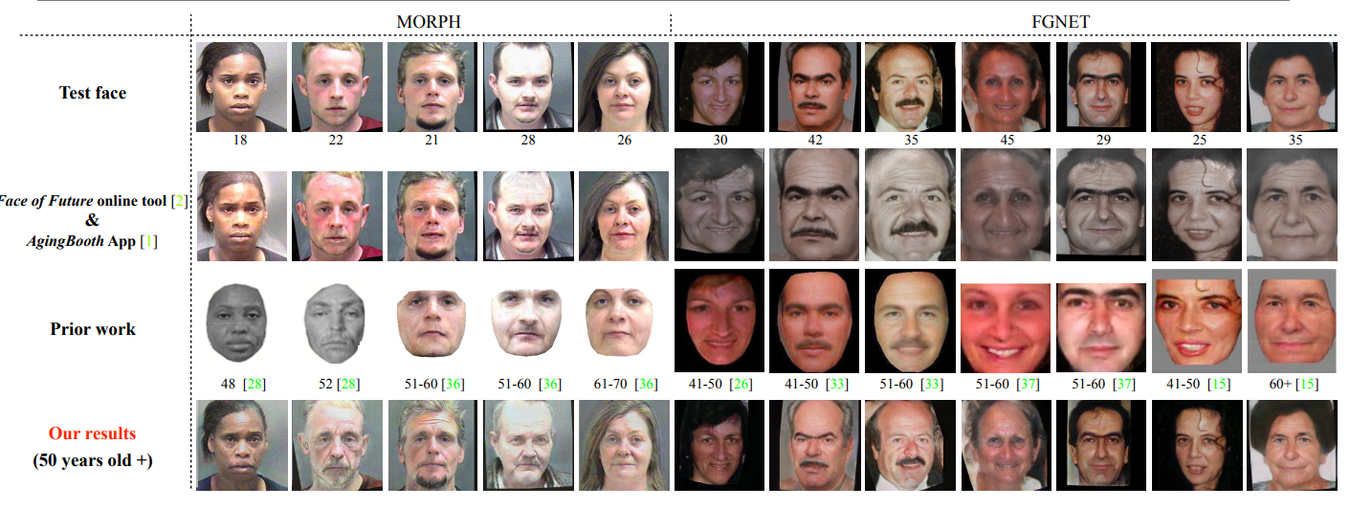
Results

Slide 15
Contributions
Ali Khalid (MSDS21001)
Interim Report
Presentation
Final Report
Coding
Muhammad Maisam Abbas (MSDS21003)
Interim report
Presentation
Final Report
Coding

Slide 16
References
[1] Todd, James T., et al. "The perception of human growth." Scientific american 242.2 (1980): 132-145.
[2] Wu, Yin, Nadia Magnenat Thalmann, and Daniel Thalmann. "A plastic-visco-elastic model for wrinkles in facial animation and skin aging." Fundamentals of Computer Graphics. 1994. 201-213.
[3] Wang, Wei, et al. "Recurrent face aging." Proceedings of the IEEE conference on computer vision and pattern recognition. 2016.
[4] Nhan Duong, Chi, et al. "Temporal non-volume preserving approach to facial age-progression and age- invariant face recognition." Proceedings of the IEEE international conference on computer vision. 2017.
[5] Ricanek, Karl, and Tamirat Tesafaye. "Morph: A longitudinal image database of normal adult age- progression." 7th international conference on automatic face and gesture recognition (FGR06). IEEE, 2006.
[6] Chen, Bor-Chun, Chu-Song Chen, and Winston H. Hsu. "Face recognition and retrieval using cross-age reference coding with cross-age celebrity dataset." IEEE Transactions on Multimedia 17.6 (2015): 804-815.

Slide 17
Questions?

